Slide 1
Framing Your Shot

Slide 2
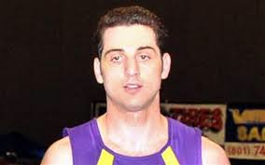
Look for Clear Backgrounds
Be aware of lampposts, trees or other such objects that are directly behind your subject.
A flagpole protruding from the top of an actor's head looks ridiculous.
Steer clear of any visual distractions.

Slide 3
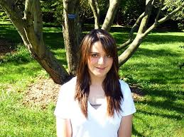
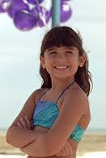
Examples of Poor Backgrounds

Slide 4
Subject should be well lit
Make sure that the subjects face is well-lit

Slide 5
Compare and Contrast

Slide 6
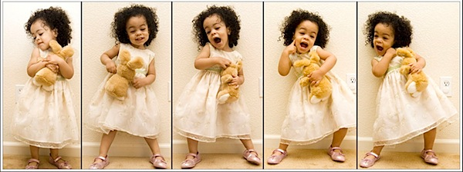
Shooting Children
Shoot at face-level so that features can be seen, this is especially important when shooting children.

Slide 7
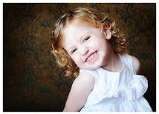
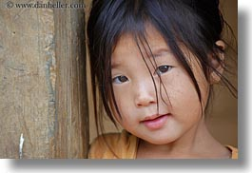
Examples

Slide 8
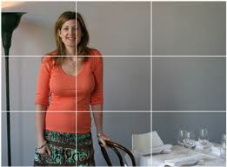
Rule of Thirds
Divide the shot into nine sections, as in the frame below.
Points of interest should occur at 1/3 or 2/3 of the way up (or across) the frame, rather than in the center.

Slide 9
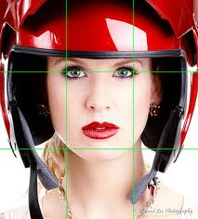
Examples

Slide 10
Facing Direction
In most cases the subject is facing slightly left or right of the camera.
Avoid severe profile shots

