Slide 1
Editing Basics
using Premiere Elements 10

Slide 2
Video Editing
The process of manipulating video to create a story.
Aspects of video editing include
rearranging, adding, or removing video clips
adding or changing sound tracks
Adding transitions between video clips
Adding titles and credits
Adding special effects

Slide 3
Video Editors
There are many video editors such as iMovie, Movie Maker, Final Cut, and Premiere Elements
Most modern video editors have the following features:
reference based: the video editor does not change the original video it merely points to it.
non-linear: you don’t have to work on clips in the order they were shot
multi-tracks: you can have more than one video or audio layered on top of each other.

Slide 4
Premiere Elements 11
Created by Adobe (the same people who created Adobe Reader and Photoshop)
It is Adobe’s easier to use video editor. Premiere Pro has more features but takes longer to learn.

Slide 5
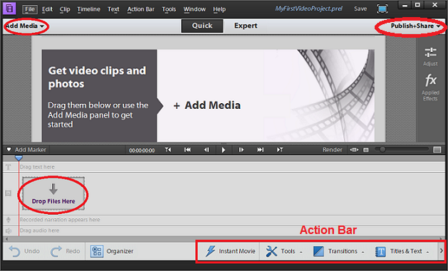
Workspace
Atomic Learning A: 2, 3
Notes:
Atomic Learning – A: 2, 3

Slide 6
Adding Media
Both video and photos can be used in Premiere Elements
To add video or photos click on Add Media in the task panel
Select “Files and Folders” and browse to where you video and photos are stored.
Notes:
Atomic Learning – E: 2, 3

Slide 7
Task #2
Import all of the video clips from the Student Common drive and my folder
Watch each of the clips you chose (double click on the video in the task manager to preview it)
Experiment with the preview controls, including making the preview larger.

Slide 8
Working with Video Clips
Clips must be moved either to the timeline or the sceneline before you can edit them
To add a clip to the timeline drag the video clip to the video track and time location you want.
You’ll see the video on both the video and audio tracks

Slide 9
Arranging Clips
To rearrange clips in either the timeline or the sceneline click on the clip and hold the mouse button down and move the where you it to go.
To delete a clip, select it and click the delete button or right click and choose clear.
When you delete a clip it only removes it from your timeline or sceneline not the project and it does not delete the actual video.
Atomic Learning F: 1, 2, 5

Slide 10
Looking at Clips
Sometimes you want to see the whole clip and sometimes a very specific part of a clip.
You can zoom in and out of clip by moving the zoom slider left or right
This does not change the length of the clip, only how much you can see of it.

Slide 11
Watching Clips
using the time marker
arrow keys to step through video
play buttons
viewer (time included)

Slide 12
Splitting Clips
Sometimes you only want part of a clip or want to rearrange a clip so you need to split it apart.
To split a clip find where you want to break it apart on the time line and then choose the pair of scissors icon on the monitor panel time line

Slide 13
Grouping Clips
Sometimes you may want to group clips to make them easier to work with.
To group clips, select the clips you want to group and then right-click and select Group

Slide 14
Trimming Clips
Sometimes you want to shorten a clip to remove unwanted portions.
Click on the clip in the sceneline
Set the in and out markers to trim the clip.
Atomic Learning F: 3, 6, 9, 10

Slide 15
Task #1
Open Premiere Elements
Choose New Project
Named the project “practice 1” and set it to be saved in your H drive.

Slide 16
Task #2
Add the “I Want Candy” clip to the timeline
split the clip at the transitions (you will need to zoom in on the clip to split the clip right at the transition)
The transitions are overlaps in this clip. Trim the new clips so that you have clean transitions.
Rearrange the clips so that all of the individual kids are at the front of the video and group shots are at the end.
Group the clips and view them.

Slide 17
Premiere Elements 11
switch between expert and quick mode
zoom slider; fit to visible timeline
timeline marker
scissors in quick view
play buttons:
step by arrow buttons

